Slide 1
Wedgewood Elementary Back to School Night
September 10, 2020

Slide 2
Agenda
Looking Back at 2019-2020
2020-2021 Priorities
Student Learning in 2020-2021
Supporting Student Learning at Home
Schoolwide Plan (House Bill 509-Act 555)
Appendix

Slide 3
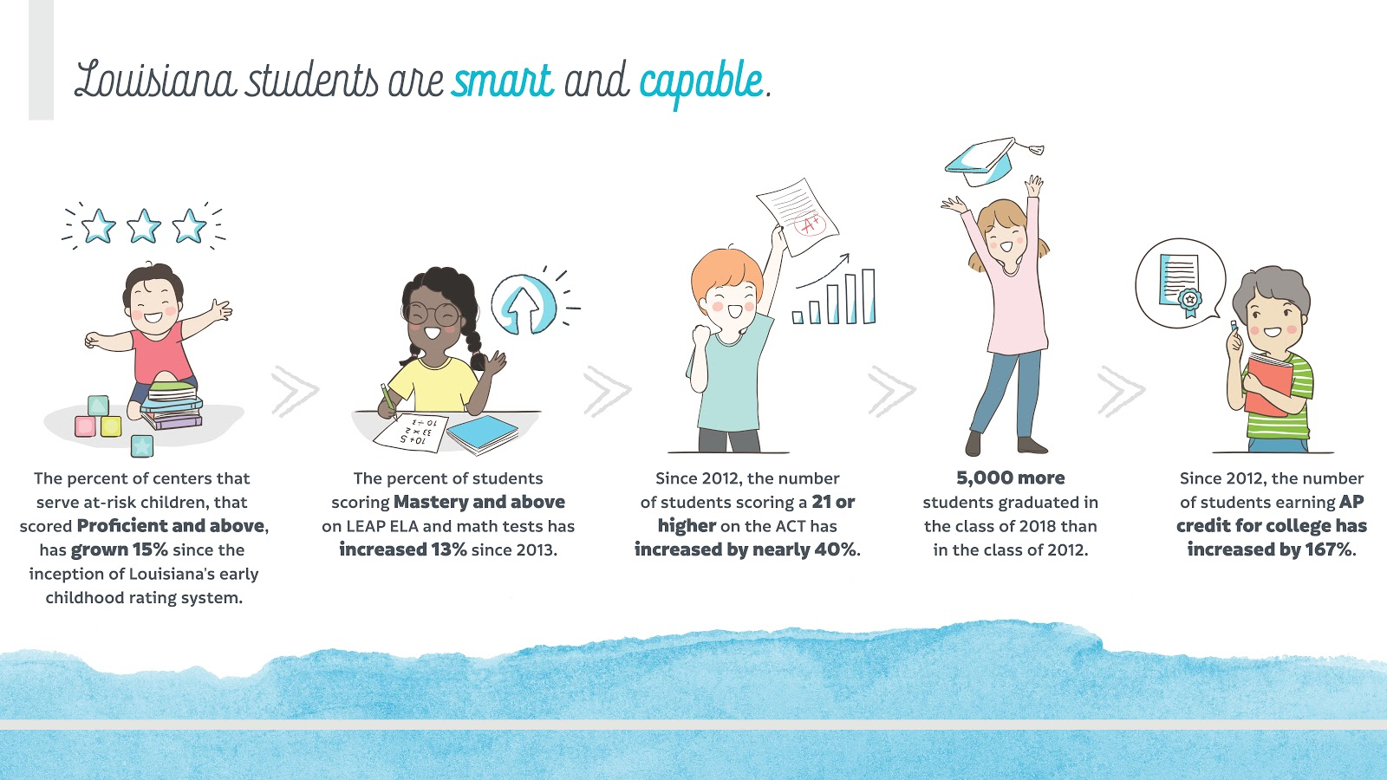
Louisiana Student Success

Slide 4
Wildcat Pride in 2019-2020
Our Wildcat nation had a great year in 2019-2020. Here are a few of our successes:
Chartered the National Junior Beta Club.
All 4th graders increased in ELA, Math, Science, and Social Studies from the previous year.
98 percent of our 5th graders successfully transitioned to middle school.
75 percent of our families attended both of our student-led parent conference nights.
Established an active PTO.

Slide 5
Release of Spring 2019 LEAP Student Reports for ELA, Mathematics, and Social Studies
The week of July 16, 2019, parents and students received three student reports, one for ELA, math, and social studies that outline how your child performed on these tests.
The reports include the following measures:
An overall score in math, English, and social studies.
A breakdown of the child’s performance into specific skills for each subject area.
How the child is performing in comparison to other students in the same school, school system, and state.
Due to the fact that the science test was new this year, students will receive results from this test later this month.
2019 Testing was waived due to COVID-19.

Slide 6
Questions to Guide Teacher Conferences
The test results will help you, as a parent, talk to your child’s teacher(s) about additional supports or enrichment that may be needed in class and at home this school year.
Here are some helpful questions to ask when discussing the results with your child’s teacher(s):
What can be done to appropriately challenge my child in areas where he or she exceeds the expectations?
Where is my child doing well and where does he or she need improvement?
How can I help support my child’s learning at home?
How do we ensure that my child makes progress?
What can be done in the classroom to help improve his or her area(s) of weakness?

Slide 7
Agenda
Looking Back at 2019-2020
2020-2021 Priorities
Student Learning in 2020-2021
Supporting Student Learning at Home
Schoolwide Plan (House Bill 509-Act 555)
Appendix

Slide 8
2020-2021 Wildcat Goals and Priorities
Based on our students’ performance in 2018-2019, Wedgewood Elementary is focused on the following priorities for the 2020-2021 school year.
Ensuring that 75 percent of students who begin the year behind grade-level, end the school year on or above grade-level (based off of LEAP 2025 results)
Increasing access to our gifted and talented program by screening students weekly for an exceptionality.
Providing all students with interventions in class and out of class.
Providing families with the tools and support they need to support student learning at home through our new parent center
Success Maker
Leveled Literacy
Standards Based Remediation
After School Tutoring
(3-5)

Slide 9
Agenda
Looking Back at 2019-2020
2020-2021 Priorities
Student Learning in 2020-2021
Supporting Student Learning at Home
Schoolwide Plan (House Bill 509-Act 555)
Appendix

Slide 10
Louisiana Student Standards
Educational Standards:
set clear and consistent learning expectations for students and teachers;
define what students should know and be able to do in a particular subject at each grade level; and
help set high goals for all students.
Standards help students to:
Develop deep understanding, skill, and fluency in mathematics
Think critically in mathematics through speaking, writing, and solving problems
Apply mathematics to real-world problems and tasks
Build knowledge, discuss, and write about topics, themes, and ideas in complex texts
Support thoughts and opinions about complex text using evidence
www.louisianabelieves.com/academics/academic-standards
Why are standards important?
The Louisiana Student Standards assure that all students, regardless of their address, background, or ability, have a clear roadmap to success in college or a career.
Clearly defined goals help families and teachers work together to ensure that students succeed, have access to extra assistance when they need it, and are challenged appropriately.

Slide 11
Our Curriculum
Content | Curriculum | Why do we use it?
Mathematics | Eureka | Builds number sense Helps students learn to apply mathematics to real-world situations Builds efficiency with mathematics problems
English language arts | Guidebooks | Provides engaging texts Integrates reading and writing so students write about what they read Provides ample opportunity for student conversations
Science | Great Minds | provides ample opportunities for students to investigate scientific questions helps students use science to explain real-world happenings integrates reading a variety of sources
Social studies | DBQ Project (Supplementary Resource) | Provides primary sources Engages students in writing about history
.

Slide 12
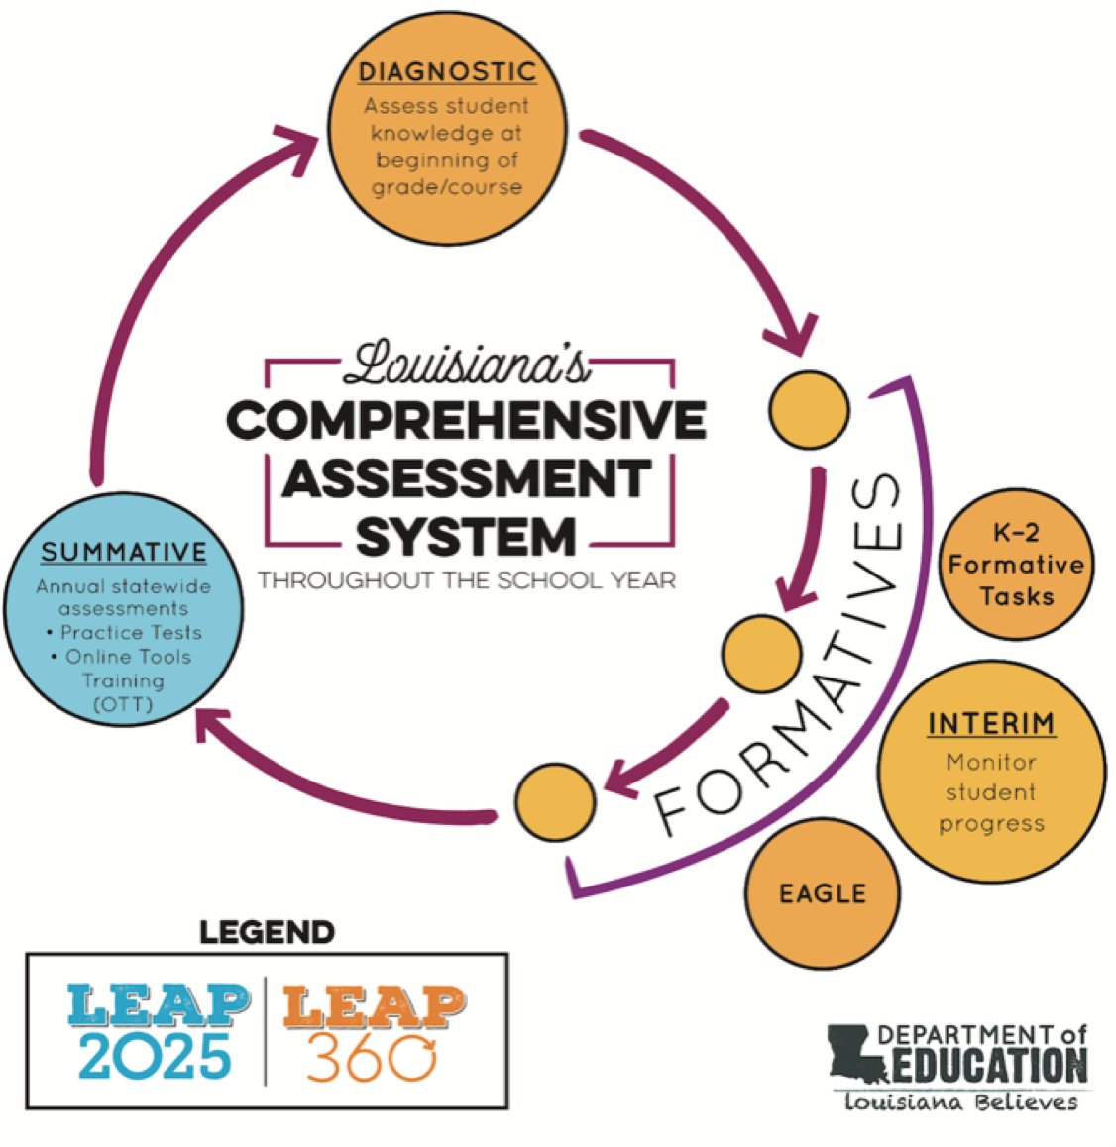
Monitoring Student Progress
LEAP 360 provides our teachers with meaningful information about how well students are progressing towards their learning goals throughout the year.
This system also allows teachers to reduce the amount of tests provided to students throughout the year.
Diagnostic Assessments, given at the beginning of the year, help teachers and students better understand students’ readiness for grade-level content and set learning goals for the year.
Interim Assessments provide valuable checkpoints to monitor student progress throughout the year.
EAGLE and K-2 Formative Tasks can be used for ongoing classroom assessments.
You can access a copy of the Parent Guide to LEAP 360 on the Department’s website in the Family Support Toolbox.

Slide 13
End of Year Tests: LEAP 2025
At the end of this school year, students in grades 3-8 will take the following state tests:
Students in grades 3 will take the LEAP 2025 assessments in ELA, mathematics, social, and science studies on paper.
Students in grades 4-8 will take the LEAP 2025 assessments for ELA, mathematics, social studies, and science online.
This slide should be updated based on your school’s/school system’s assessment mode decision for grades 3 and 4.

Slide 14
Agenda
Looking Back at 2019-2020
2020-2021 Priorities
Student Learning in 2020-2021
Supporting Student Learning at Home
Schoolwide Plan (House Bill 509-Act 555)
Appendix

Slide 15
Parent Engagement
Wedgewood Elementary is committed to providing parents with meaningful, two-way communication opportunities with both teachers and Principal Struthers throughout the year. Here is where to go with questions.
Contact your child’s teachers with questions about your child’s progress, learning needs, or school events/programs. You can schedule a conference through the front office.
Additional questions or concerns that cannot be addressed by your child’s teacher, should be directed to Principal Williams at bwilliams13@ebrschools.org
Weekly Newsletters
Monthly Newsletters
School Website

Slide 16
Supporting Student Learning
Why should families support student learning at home?
Learning should not end in the classroom.
You play an important role in setting high expectations for learning.
You can help your child become successful both in and outside the classroom.
Support starts with meaningful conversations:
Find out what your child knows.
Discover what your child should be able to do.
Talk to your child regularly about schoolwork.
Meet and speak with your child’s teacher(s) regularly.

Slide 17
Tools and Resources to Support Parents: General
Below are additional resources that you can access to further support your child’s learning at home.
Louisiana’s Family Support Toolbox Library: information on standards, test results, and all parent guides www.louisianabelieves.com/resources/family-support-toolbox
Great Kids Milestones: free online collection of videos showing what success looks like in reading, writing, and mathematics in grades K–12 www.greatschools.org/gk/milestones/
Eureka Mathematics Support Page: free online site to support students in schools that have adopted the Eureka mathematics curriculum www.greatminds.org/math/parents
LearnZillon: free online site to support students in schools that have adopted the ELA Guidebooks curriculum www.learnzillion.com/resources/81666-english-language-arts-guidebook-units
PTA Family Guides: tips for helping your child succeed in key learning areas.
https://www.pta.org/home/family-resources/family-guide

Slide 18
Agenda
Looking Back at 2019-2020
2020-2021 Priorities
Student Learning in 2019-2020
Supporting Student Learning at Home
Schoolwide Plan (House Bill 509-Act 555)
Appendix

Slide 19
Building and Assessing Foundational Skills in PK-2
Children in grades PK-2 must develop foundational skills to become proficient readers in grades 3 and beyond.
These foundational skills include:
knowing that text is read left to right and top to bottom;
recognizing sounds in spoken words;
alphabet knowledge;
letter-sound relationships;
decoding regularly spelled words;
reading irregularly spelled words; and
reading grade level texts with accuracy, rate, and expression.
Teachers build children’s foundational skills by using high-quality curricula and small group instruction each day.
Teachers will assess these skills formally 3-4 times a year to monitor student progress, and will informally assess students daily by observing, listening, and probing during instruction.

Slide 20
Progression of PK-2 Foundational Skills
By the end of... | Children are able to...
PreK | Demonstrate that print is read left to right and top to bottom Recognize and produce rhyming words
Kindergarten | Recognize and name all upper and lowercase letters of the alphabet Produce the primary sound/symbol relationship for every letter
First | Decode regular, one- and two-syllable words Read grade level text orally with accuracy, appropriate rate, and expression
Second | Read irregularly spelled words Read grade level text independently with sufficient fluency to support comprehension

Slide 21
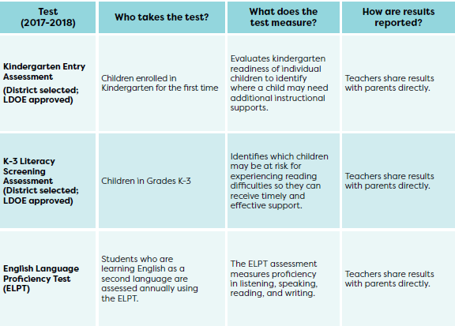
PK-2 Assessments
Students in grades Pre-K-2 are given screening assessments to:
determine their readiness for Kindergarten and
help identify whether or not they are learning what they need to meet grade level norms, and need additional support.

Slide 22
Return to School Guidance
Dear Wedgewood Families, The WES administrative team, faculty and staff have been preparing to officially reopen school to students on September 14, 2020. What follows is the result of much thought, discussion and planning in collaboration with EBRPSS, guidance from Centers for Disease Control and Prevention (CDC) and the Louisiana Department of Education. We believe these plans will help us keep our community as safe and healthy as possible while returning our school to operations. Our routines and daily interactions will look different this year and will adjust as needed to ensure adherence to health related policies and protocols. As we move forward, please know that safety is our priority with an equal focus on continuing to provide our students with a comprehensive education and experience. We look forward to partnering with all of you as we navigate the challenges that COVID-19 presents to us. As a Wildcat community, we are stronger together!

Slide 23
Wellness and Logistics
Temperature checks will be conducted upon arrival at school and/or during visits to the school nurse. Students with 100.4+ temperature may not remain on campus. Parents will be contacted to come pick students up and should call the front office upon arrival. A staff member will bring the student to your vehicle.

Slide 24
Arrival and Dismissal
School buses used to transport students must not exceed the following maximum capacity requirements: a. Phase One – 25%, including adults, of the maximum capacity of the bus as determined by the bus manufacturer; b. Phase Two – 50%, including adults, of the maximum capacity of the bus as determined by the bus manufacturer; and c. Phase Three – 75%, including adults, of the maximum capacity of the bus as determined by the bus manufacturer. Passengers on a school bus must be spaced to the greatest extent possible as follows: a. Phase One – Passengers must ride one (1) per seat except that members of the same household may sit in the same seat or adjacent seats. Every other seat on the bus must remain empty; and b. Phases Two and Three – Passengers must be dispersed throughout the bus to maximize social distancing to the greatest extent possible. o Carpool students will have their temperatures taken prior to exiting the vehicle. Please have your window rolled down and be ready for daily temperature checks in the morning. This will help expedite the process. A staff member will come up to the vehicle to take your child’s temperature.

Slide 25
In Case of Illness
Students who are COVID-19 positive must stay at home until deemed noninfectious by a doctor. o It is important that we care for one another and protect one another from illness to the fullest extent possible. Please follow these guidelines in case of illness in your household: o Students who are sick should stay at home (regardless of illness). o Parents are to report if their child has been on fever reducing medication in the prior 24 hours or has had a cough or shortness of breath or any COVID-19 related symptoms as designated by the CDC including body aches, headache, loss of taste or smell, nausea, sore throat, congestion and/or a runny nose.

Slide 26
Hygienic Supplies
Students, employees, and school visitors shall be provided adequate access to hygienic supplies, including soap, hand sanitizer with at least 60% alcohol content, disinfectant wipes or spray, paper towels, and tissues. The quantity of hygienic supplies in each school or work location must be appropriate to the needs of that facility, and the quantity of hygienic supplies in individual classrooms must be appropriate to the role and the number and age of students or adults in such classroom. Students and employees are expected to bring their own face coverings with them to school and/or work each day. However, disposable face coverings shall be available at each school for students, employees, and guests who do not have their own coverings on a particular date.

Slide 27
Face Masks
While inside any school facility or on school buses, all students in grades 3 through 12 and all employees and visitors are required to wear face coverings to the greatest extent possible and practicable. o Face Covering means a piece of material used to cover both the nose and mouth for the purpose of forming a barrier to droplets or airborne particles that are coughed, sneezed, or exhaled when talking. Face coverings are meant to protect both the wearer of the face covering and surrounding individuals. o The face covering is considered part of the school uniform/dress code for both students and employees (see Board policy/student handbook/employee handbook). The failure/refusal of employees and students to wear such face coverings shall result in their immediate separation from others and, for students, notification to the parent/custodian. Thereafter, the incident shall be treated like all other violations of Board policy and/or the student/employee dress/grooming code. o While inside school facilities or on school buses, students in grades preKindergarten through 2 may wear face coverings but are not required to do so. o While inside school facilities or on school buses, children under two (2) years old may wear face coverings but are not required to do so. Face coverings need not be worn by employees or students who are outdoors and who are able to maintain social distancing of at least six (6) feet. o Notwithstanding the above, any individual who contends that he/she has a disability or condition, which prohibits him/her from wearing a face covering inside school facilities or on school buses shall have the right to seek an exception to such requirement through the procedure outlined in Section J(1), (2), and (3) below.

Slide 28
Social Distancing
Social distancing will be implemented to the fullest extent possible. o Classrooms will be arranged for 6ft. spacing. o Students will move about the building using designated flow paths during transitions between classes and activities. o Students will participate in recess and P.E. with social distancing and “hands-free” games or activities. If equipment is used, it will be sanitized after use. Students will sanitize their hands before returning to the classrooms. o Gatherings, such as assemblies and special events, will adhere to current Phase-level guidelines.

Slide 29
Visitors
Throughout COVID-19 restrictions, visitors will be allowed in the school building only in extenuating circumstances. Essential visitors must comply with the minimum health and safety standards contained in this policy including, without limitation, hand washing, temperature checks, and the wearing of face coverings. Please call the front office for additional information.

Slide 30
Enhanced Cleanliness
WES will operate using the increased cleaning protocols recommended by the CDC to ensure that all campus buildings are cleaned and disinfected consistent with that guidance. Antibacterial wipes/disinfectant spray will be used on high-touch and learning surfaces as groups change. o All individuals will use hand sanitizer at arrival, at every class change, before and after eating or using play equipment and at exit/dismissal.
• Lunch o Breakfast and lunch for each student shall be prepared by the cafeteria staff under the direction of the cafeteria manager. The cafeteria manager shall be responsible to see that meals are distributed to students in such a manner as to limit contact between the cafeteria staff and students. o To the extent possible, lunch will be served in the classrooms. Students will be seated appropriately and hygiene protocols will be followed.

Slide 31
Water Fountains
In adherence with safety guidelines, water fountains will be turned off. Students should bring a water bottle with a closed top.
• Emotional Well-being .As part of the school’s planned reopening, guidance and administrative staff are always available to conduct individual and small group support based on student, instructor and parent referrals to help students cope with any COVID-19 related issues: reentry stress, anxiety, trauma, and loss.

Slide 32
Materials Distribution
Hybrid students will receive Progress Reports and all textbook materials in person next week.
Parents of students that are remaining virtual can pickup textbooks and Progress Reports Friday, September 18, 2020 between the hours of 1:00 p.m.-2:00 p.m.
Drive thru process at the front of the school.

Slide 33
Student Supplies
Hybrid students can begin bringing school supplies next week. You can send items multiple days so that students do not have to carry a large load.
Virtual students can keep school supplies until they return to campus.

Slide 34
Arrival/Dismissal
In the morning, cars will only come in from Aspenwood Drive. Morning carpool will end at 8:25 am. At 8:25 am, all teachers on carpool duty must report to their classes, even if someone is turning in late. No student will be allowed to exit their car and no parent/guardian will be allowed to drive off until every student is safely on the walkway. Please do not get out of your car to walk your students in. Please take a right on Aspenwood Drive to leave the campus.
Carpool students will have their temperatures taken prior to exiting the vehicle. Please have your window rolled down and be ready for daily temperature checks in the morning. This will help expedite the process. A staff member will come up to the vehicle to take your child’s temperature. If a child has a temperature of 100.4 degrees or higher, they will not be allowed to get out of your car. If you arrive after 8:25, you will need to walk your child in and their temperature will be taken at this point before you leave.
In the afternoon, similar to mornings, cars will only come in from Aspenwood Drive. Only those coming from Aspenwood will be allowed to enter. All cars will fill into a single car line. Follow the cones until you fill into the drop off area, Students will then be called by the order you arrive. Please have your child’s carpool number when you come into carpool. Afternoon carpool ends at 3:45. Anyone not picked up by then will be placed in aftercare at a cost of $15.
These measures are for the safety of your child and every child in carpool. Here are some things you can do to help with this transition to our new system:
● Be sure to be on time for morning and afternoon carpool.
● Please do not park and walk the students into the building. That only creates a dangerous situation and holds up the line.
● Delays are inevitable so be patient when you are forced to wait.
● Do not block any driveways while in line.
● Do not block the entrance and exit at the front of the school for our buses.
● Please turn right on Aspenwood when leaving so that the line is not stopped.

Slide 35
Classroom Teacher Presentations
Please visit http://wedgewoodelem.weebly.com/ for pre-recorded Open House presentations from your child's teacher.
If you have additional questions or concerns please let us know.
Edward Roberts, Dean of Students Eroberts@ebrschools.org
Bridgette Hinton, Assistant Principal Bhinton@ebrschools.org
Brandy Williams, Principal Bwilliams13@ebrschools.org
Office 225. 753.7301

